Slide 1

Intro to JavaScript
Run By: CREATE Club UTSC
PowerPoint By: Alexander Caza

Slide 2

Background:
Invented by Brendan Eich in 1995 for the Netscape 2 web browser.
99% of websites use JavaScript on the client side for webpage behavior
High-level language
Conforms to the ECMAScript standard, a standard for scripting languages
This ensure the interoperability of web pages across different web browsers.
Managed and updated by a team in the non-profit European Computer Manufacturers Association.

Slide 3

JavaScript is an Evolving Language
Changes to the ECMAScript standard result in changes to the JavaScript language.
These can result in major changes to the language:
ES6 (2015) changes:
Changing variable definitions from var to let and const.
The introduction of multi-line strings
A complete overhaul to asynchronous programming (Promises introduced)
ES8 (2017) changes:
Another overhaul of asynchronous programming (async/await)

Slide 4
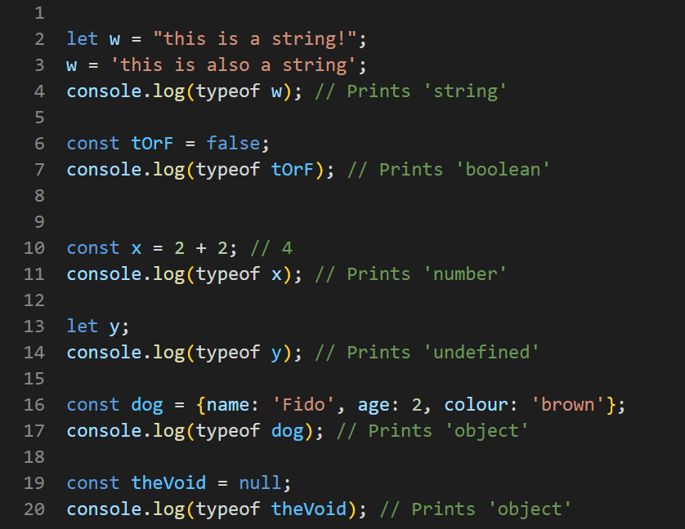
JavaScript Common Data Types
string – both ' ' and " " can be used
number – used for whole numbers, decimal and negative numbers
boolean – true or false
undefined – represents lack of defined value, for example, a variable that's only declared, not initialized
object – example for a dog: {name: 'Fido', colour: 'brown'}
null – created using the keyword null, null is actually considered an object by JavaScript

Slide 5
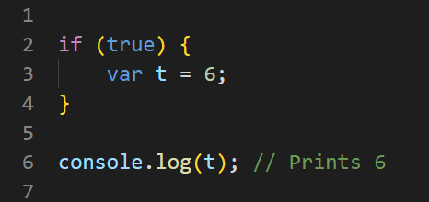
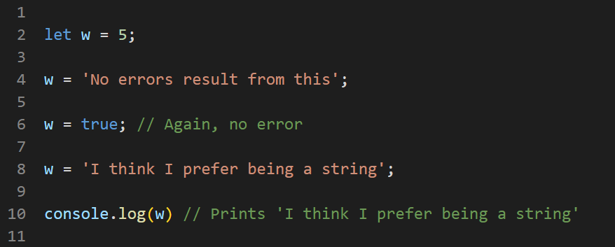
Variables in JavaScript
JavaScript is dynamically typed – you do not explicitly define the type of a variable and a variable's type can change during runtime
The var keyword:
The pre-ES6 way to define variables.
Results in the variable being globally scoped (So pre-ES6, all variables were global variables)
Superceded by let and const in ES6 (these should be used instead, although legacy code may contain var)

Slide 6
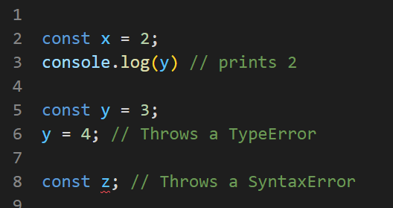
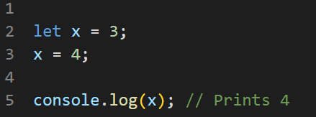
Let and const
An updated variable declaration approach in ES6
Block-scoped variables (local variables)
let keyword: variables declared this way can be reassigned
const keyword: variables declared this way can't be changed through reassignment and MUST be assigned a value as an initializer

Slide 7

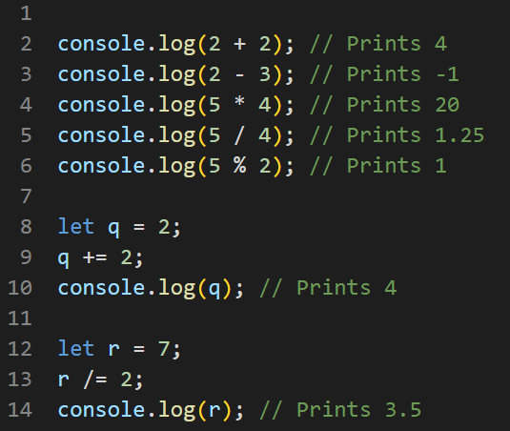
Operators
+ (addition)
- (subtraction)
* (multiplication)
/ (division, the result can be a decimal number)
% (modulo)
The above also have equivalent assignment operators:
+=, -=, *=, /=, %=

Slide 8
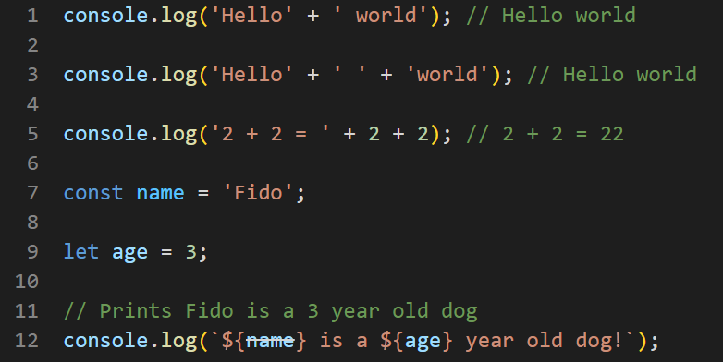
Strings
Concatenation uses +
String interpolation:
A way to create strings based on variables easily using placeholders for the variables
Format:
String surrounded by `'s (the backtick)
Variables encased in ${variable}

Slide 9
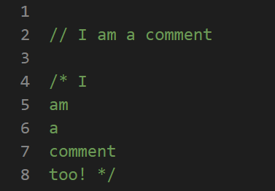
Comments
Single line: // Like this
Multiline: /* comment */

Slide 10
Logical Operators
Or: ||
And: &&
Equal: === (IMPORTANT: 3 signs not 2)
Not equal: !==
Invert the truthiness of a boolean value or expression: !
Less than: <
Greater than: >
Less than or equal to: <
Greater than or equal to: >=

Slide 11
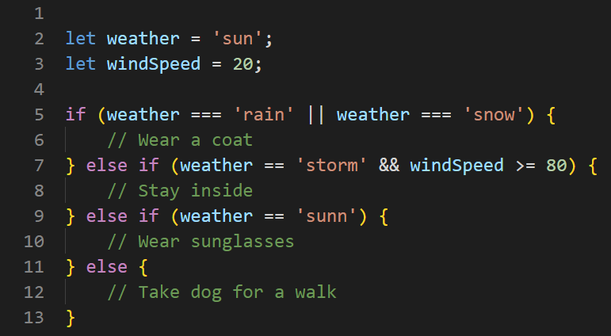
Control flow:

Slide 12
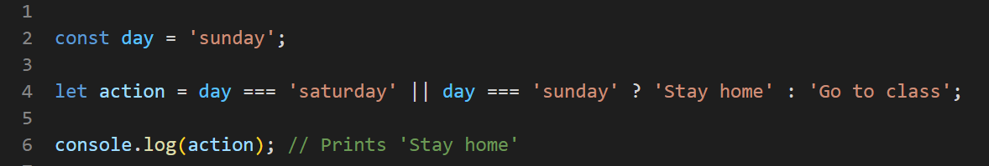
Ternary Operator (?)
A concise way to write a binary decision
Format:
condition ? expression to execute if true : expression to execute if false

Slide 13
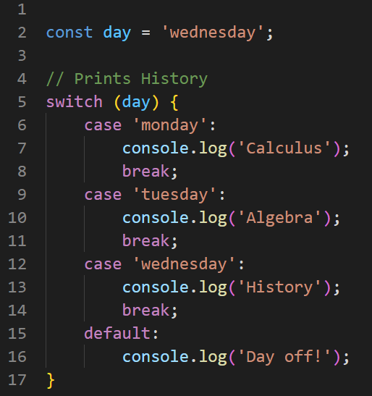
Switch Statement
An alternative to long if, else if, else chains
break: required or all the statements would be checked and possibly run
default: equivalent to else in an if statement

Slide 14
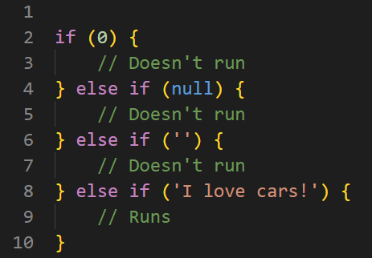
Truthy and Falsy Values
JavaScript views certain values as true or false
Falsy values: false, 0, empty strings, null, undefined and NaN (not a number)
Every other value evaluates as true

Slide 15
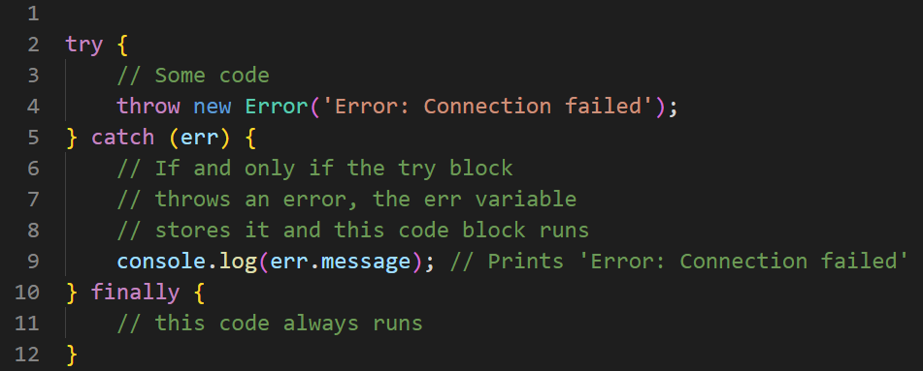
Error Handling

Slide 16
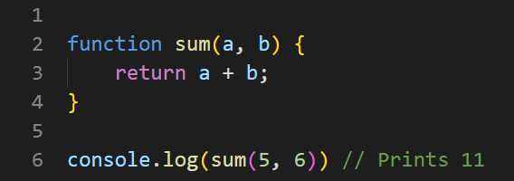
Functions (Basic)
Uses the function keyword

Slide 17
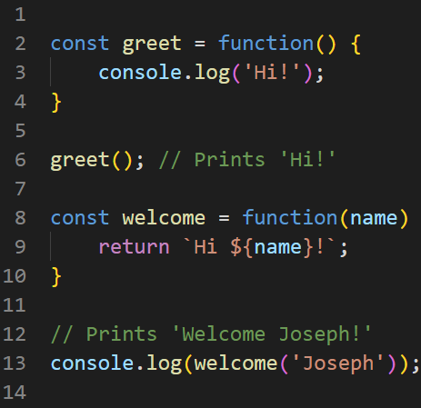
Anonymous Functions
In JavaScript, functions can be nameless and assigned to a regular variable.
These are called anonymous functions.
Invoked by calling the variable that stores it, followed by parentheses.
These functions can still take parameters.

Slide 18
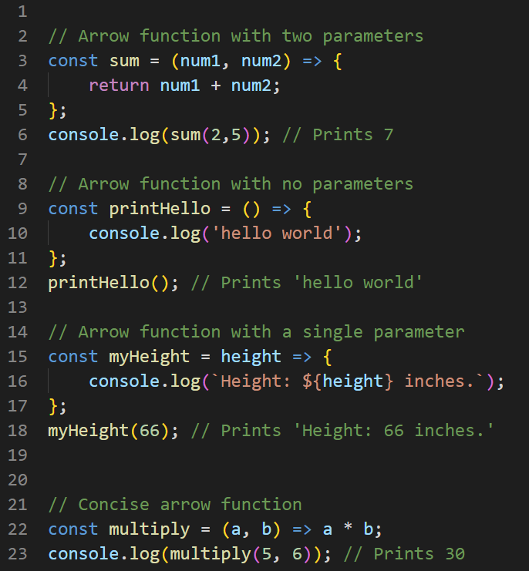
Arrow Functions
Introduced in ES6.
Clean and concise but somewhat challenging to get used to.
No need for the function keyword and uses a fat arrow => to separate the parameter(s) from the body.
Arrow functions with a single parameter do not require () around the parameter list.
Arrow functions with a single expression can use the concise function body which returns the result of the expression without the return keyword.

Slide 19
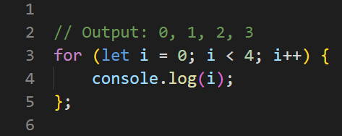
For Loop

Slide 20
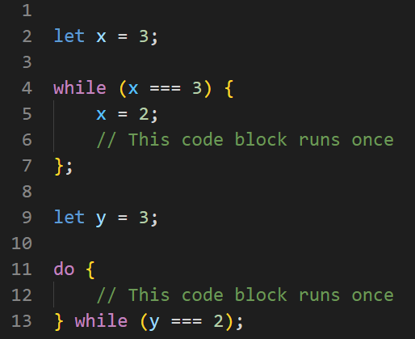
While Loop / Do-while Loop

Slide 21
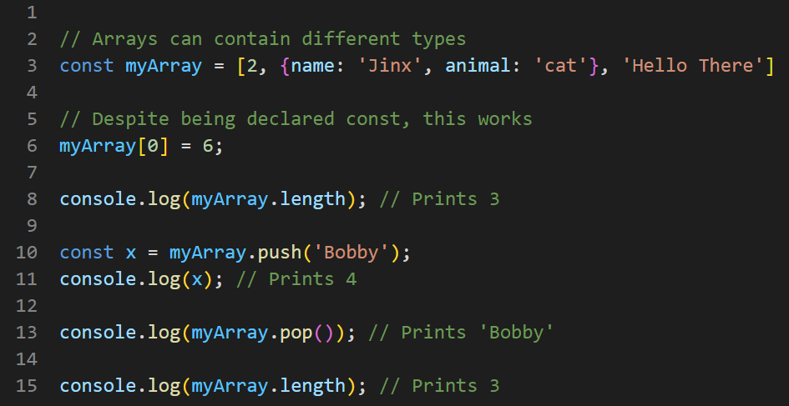
Arrays
You can mix different data types in a single array
Mutable – the contents of an array declared with const can still be changed
.length property: stores the length of the array
Accessing elements: array[index] (starts from 0)
.push() – adds the element to the end of the array and returns the length of the updated array
.pop() – removes the last element from the array and returns that element

Slide 22
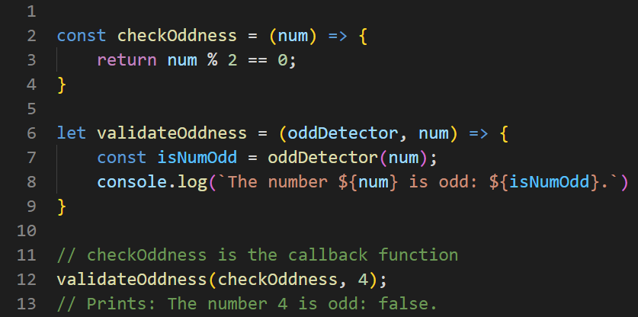
Callback Functions
A callback function is a function that is passed into another function as an argument.
This function can then be invoked during the execution of that higher order function (that it is an argument of).
A “higher-order function” is a function that accepts functions as parameters and/or returns a function.

Slide 23
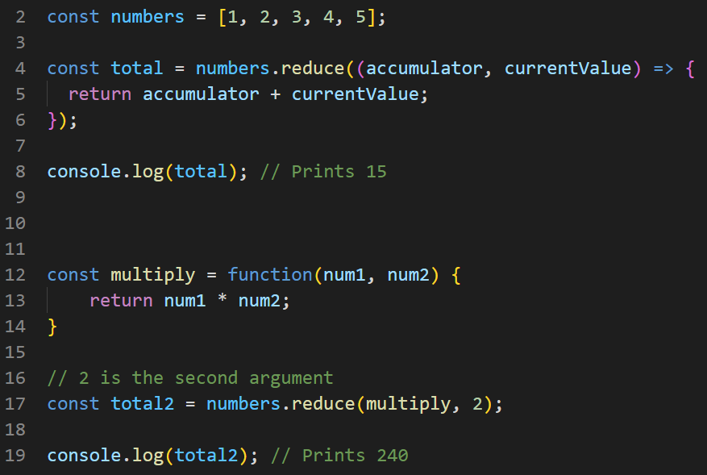
array.reduce()
The .reduce() method iterates through an array and returns a single value.
It takes a callback function with two parameters (accumulator, currentValue) as arguments.
On each iteration, accumulator is the value returned by the last iteration, and the currentValue is the current element.
Optionally, a second argument can be passed which acts as the initial value of the accumulator.

Slide 24
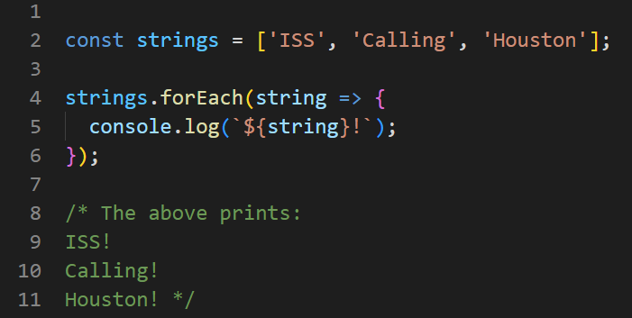
array.forEach()
Executes a callback function on each value within the array.

Slide 25
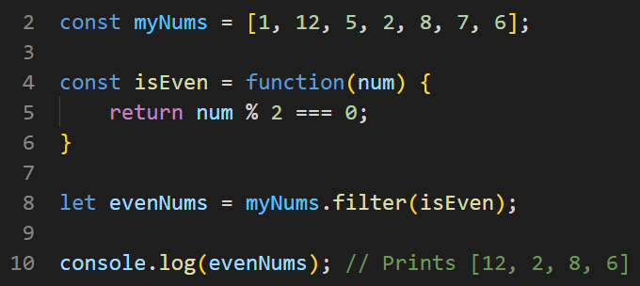
array.filter()
The .filter() method executes a callback function on each element in an array.
The callback function for each of the elements must return either true or false.
The returned array is a new array with any elements for which the callback function returns true.

Slide 26
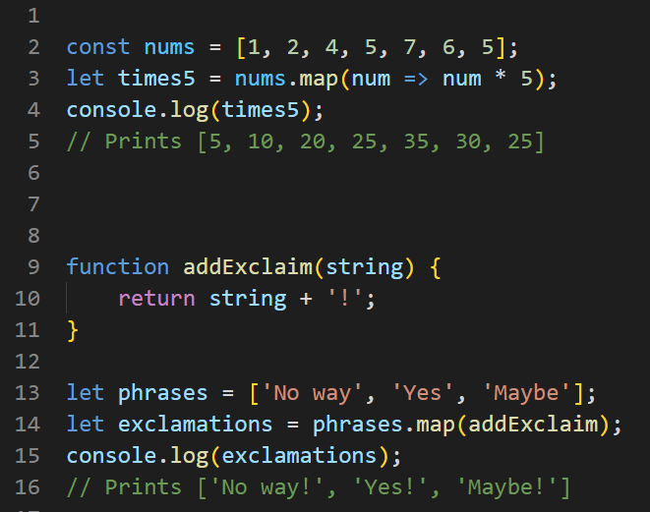
array.map()
Executes a callback function on each element in an array.
Returns a new array made up of the return values from the callback function.

Slide 27
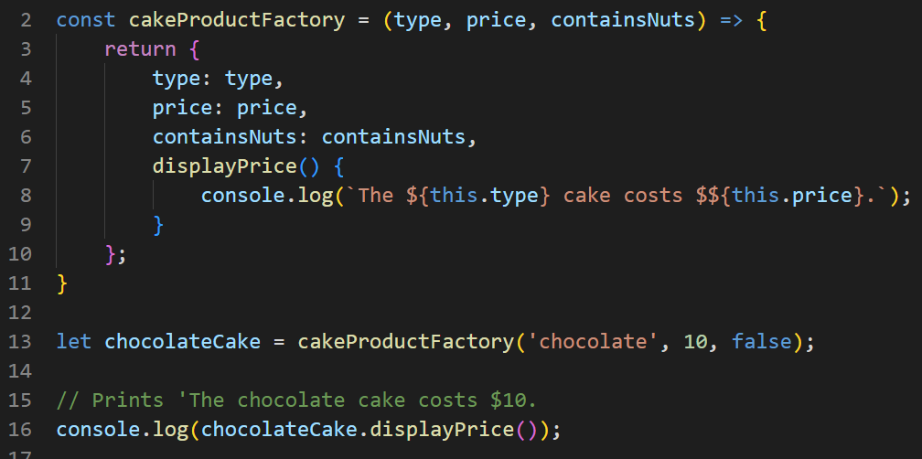
Factory Functions and Object methods
A function that returns an object.
Often accept parameters that customize the returned object.
Objects in JavaScript can contain methods.
The this keyword can be used to access the objects' properties.

Slide 28
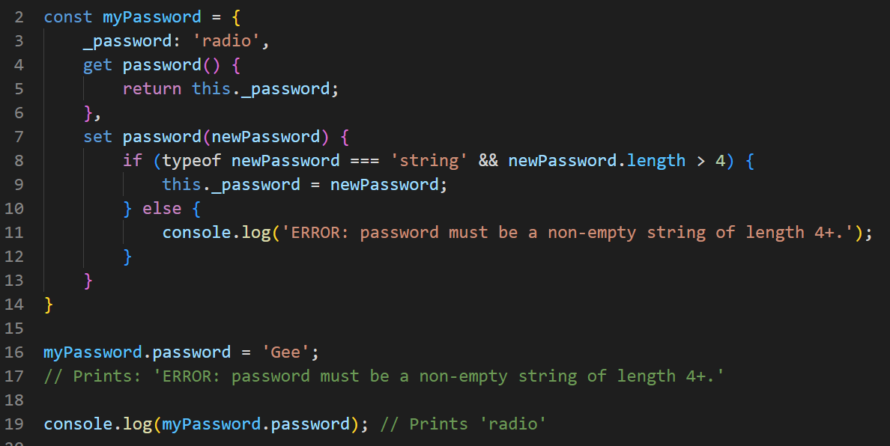
Getters and Setters
Since JavaScript objects are passed by reference and access modifiers do not exist, there is no way to fully prevent incorrect interactions with object properties.
Instead, we can use getter and setter methods.
Typically, the internal value is stored as a property with an identifier that matches the getter and setter method names, but with an underscore (_) at the start.
JavaScript getter and setter methods provide a way to intercept property access and assignment and allow for additional actions to be performed before these changes go into effect.

Slide 29
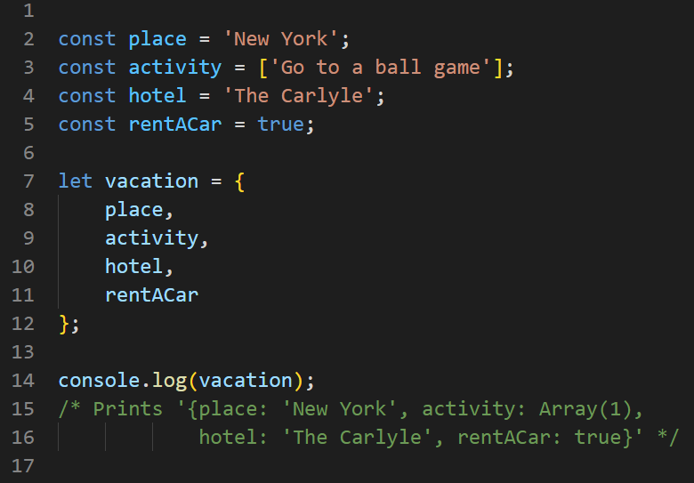
Shorthand Property Name Syntax
Allows creating objects without explicitly specifying the property names.
An object is created where the property names of that object match the names of the variables provided.
Shorthand property names populate an object with a key matching the variable name and a value matching the variable's value.

Slide 30
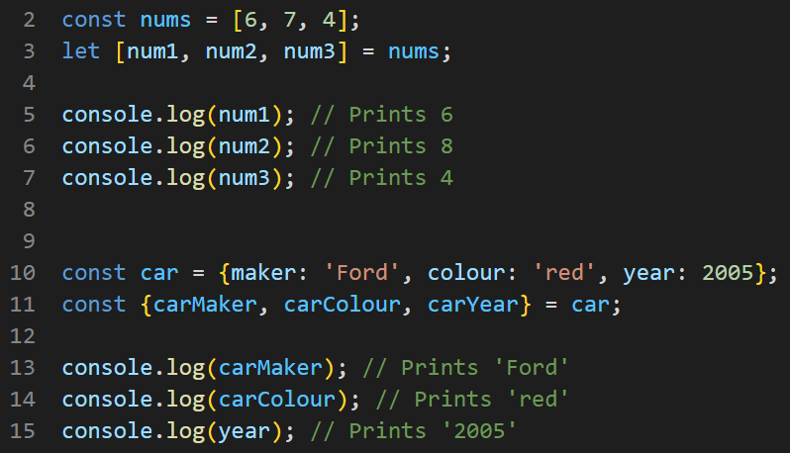
Destructuring
JavaScript syntax that makes it possible to unpack values from arrays, or properties from objects, into distinct variables.
Array or object to unpack goes to the right
Variables to store the values in go on the left – inside [] for arrays and inside {} for objects

Slide 31
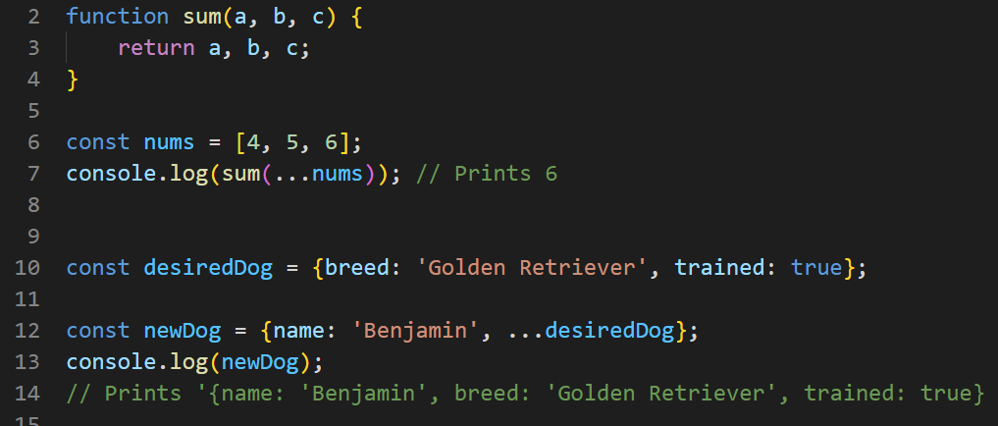
Spread Syntax (…)
Allows an array to be expanded in place.
For objects, the spread syntax enumerates the properties of an object and adds the key-value pairs to the object being created.

Slide 32
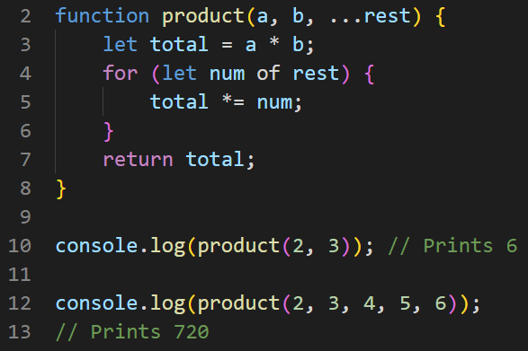
Rest Syntax (…)
Allows a function to accept an indefinite number of arguments as an array.
A function definition's last parameter can be prefixed with ..., which will cause all remaining parameters to be placed within an array.
A function definition can only have one rest parameter.
The rest parameter must be the last parameter in the function definition.

Slide 33
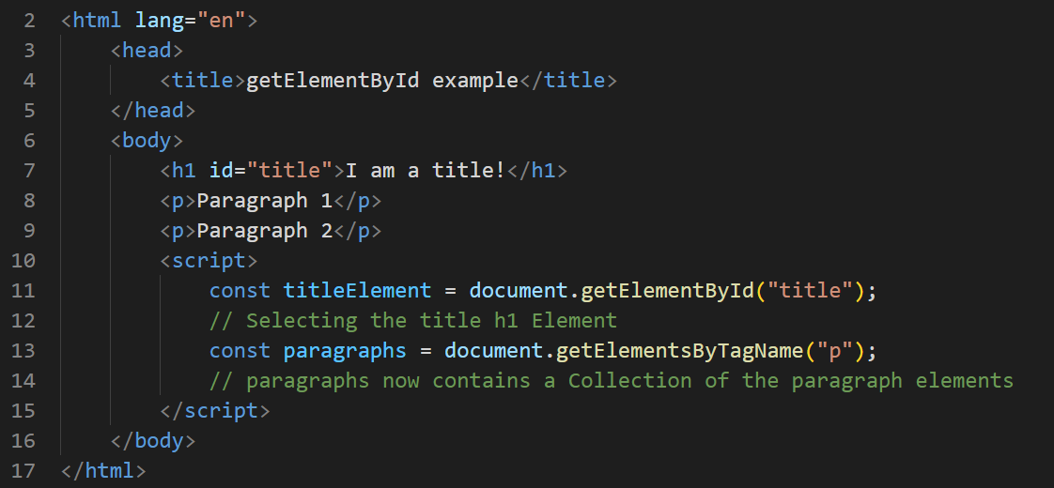
Selecting HTML elements
document.getElementById() returns an Element object representing the element whose id property matches the specified string.
Since element IDs are required to be unique if specified, this is a useful way to get access to a specific element.
Alternatives include: document.getElementsByTagName() (Returns a live-updating collection of elements of that tag)

Slide 34
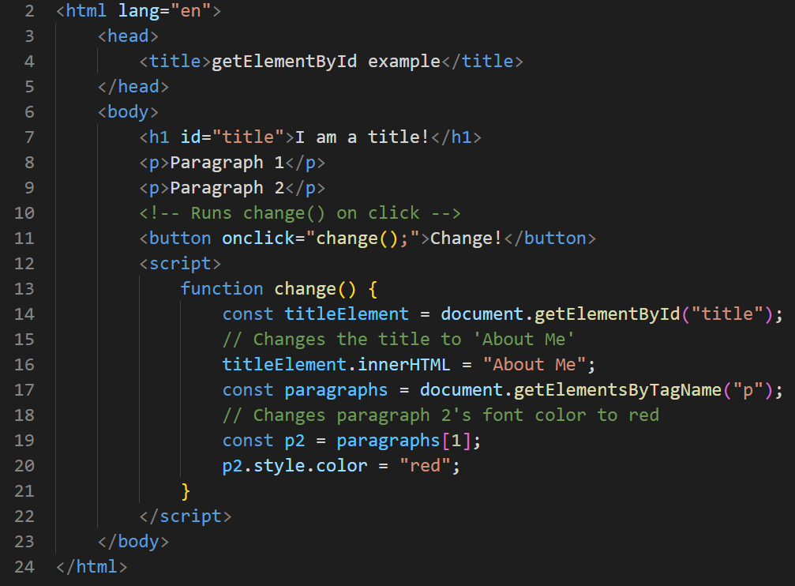
Modifying HTML text and properties
Text is accessed and modified via: element.innerHTML
Other properties are accessed and modified via: element.property
Styles are accessed via element.style.property

